Slide 1
W04 Assignment MDSC 689.03
Matt Daalder
2020

Slide 2
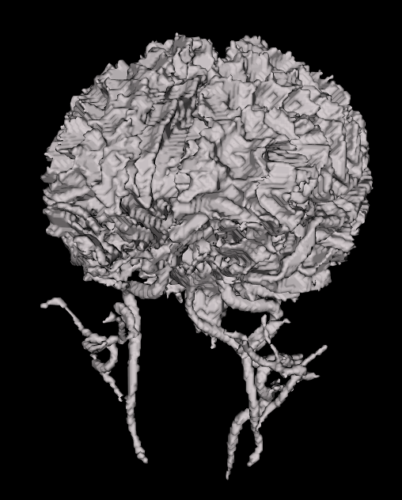
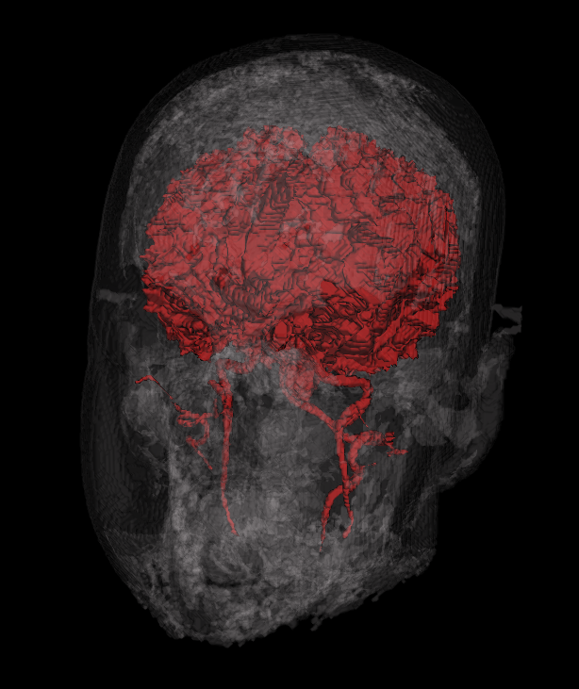
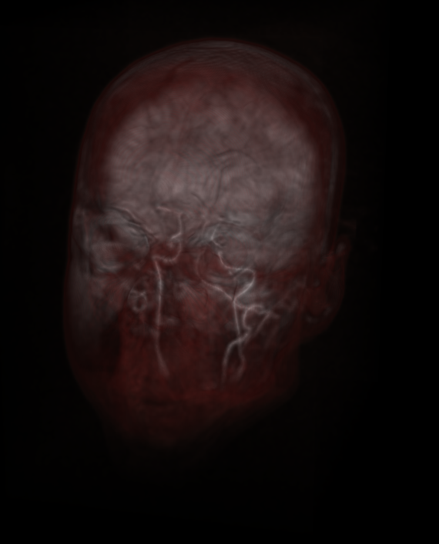
head.nii
Marching cubes
Showing white matter of the brain and some vasculature overlaid by soft tissue
Raycasting
Emphasis on internal carotid arteries with some brain, and soft tissue overlaying structures
Marching cubes
Showing white matter of the brain and some vasculature
Notes:
White matter = 500, 3000

Slide 3
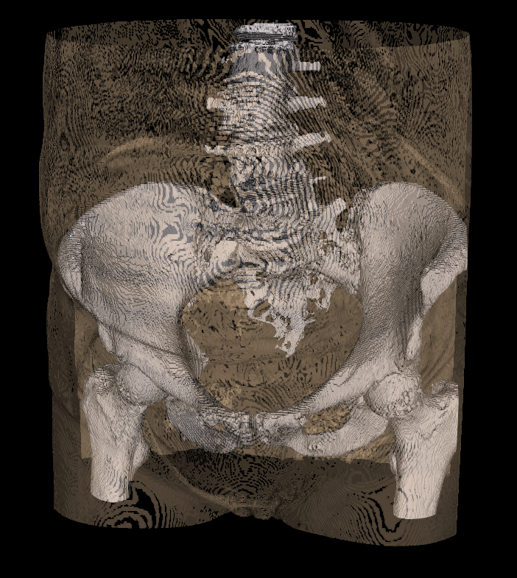
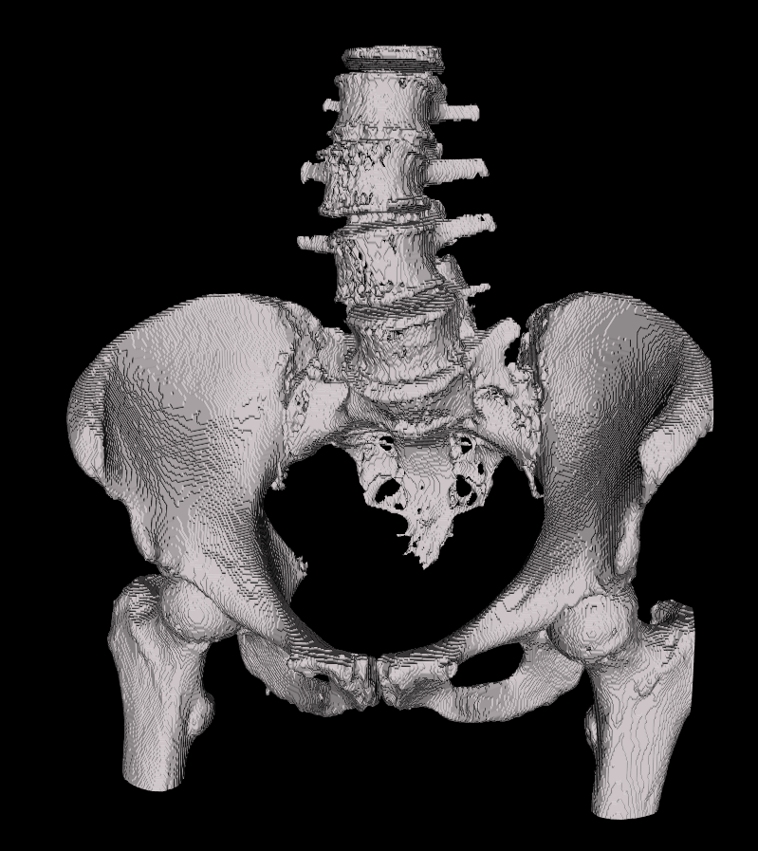
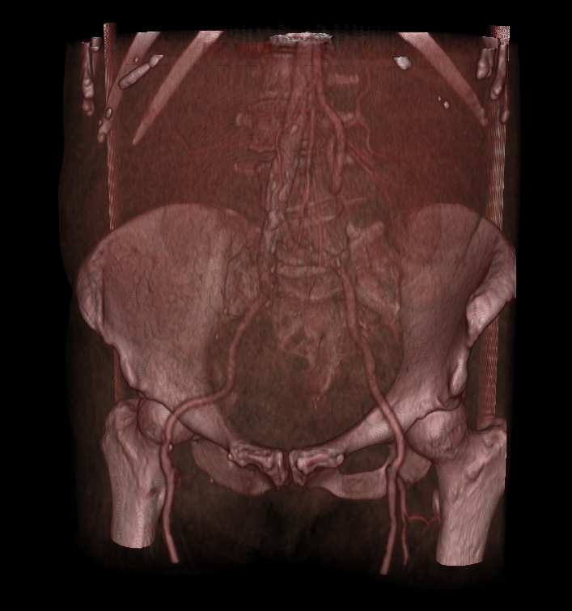
hip DICOM
Marching cubes
Showing bone
Marching cubes
2 objects with transparency.
Tried to show skin and bone.
Raycasting
Bone and vasculature
Notes:
Skin = -440, -80
Bone = 230, 3000

Slide 4
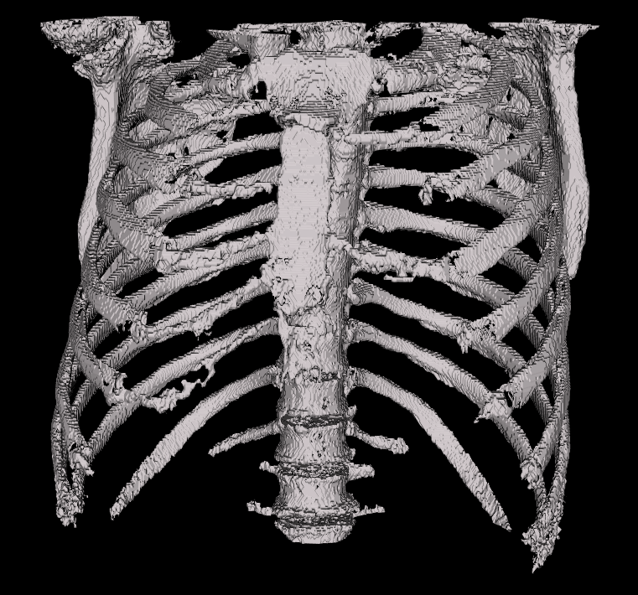
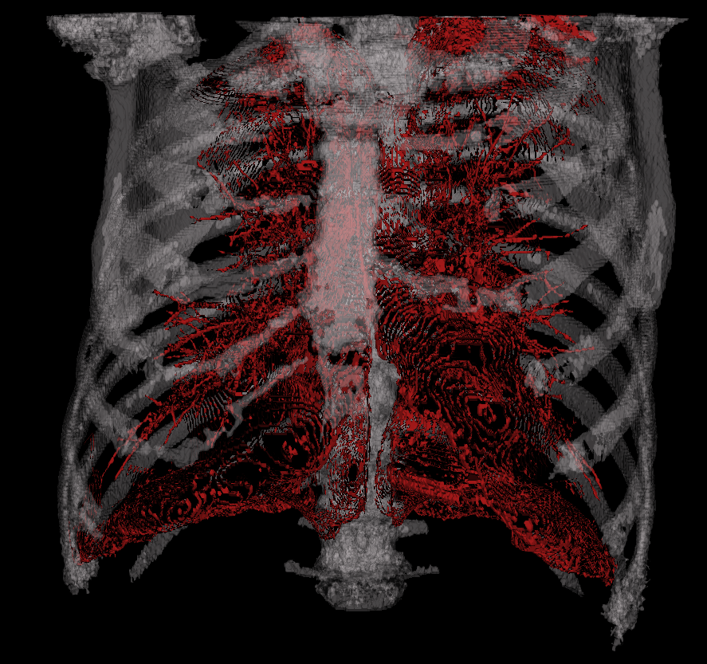
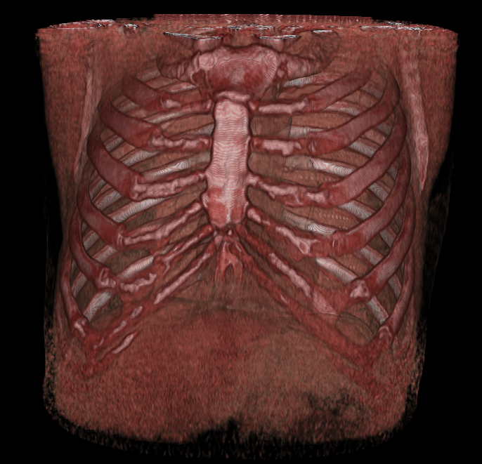
thorax DICOM
Marching cubes
Showing bone
Marching cubes
2 objects with transparency.
Tried to show bone and bronchioles.
Raycasting
Bone and some organs
Notes:
Bronchioles = -400, -150 ??? (in that range)
Bone = 230, 3000

